Slide 1
Would I Skip It? Predicting Song Skips Based on Lyric Content
Notes:
Good Afternoon everyone,

Slide 2
Hello!
Arink Bertrand
Data Scientist
Linkedin: arink-bertrand
Github: ArinkB
Notes:
My name is Arink Bertrand,
I am a Data Scientist and
Today I will walk you through my data journey in predicting song skips based on Lyric Content

Slide 3
The Problem
The Goal
Streaming service algorithms that pay closer attention to user skipping behavior and reasons
Notes:
When listening to music, one of the main things that WILL make me skip a song is if the artist sings their own name in the track.
Searching online I noticed that I am not the only one who cringes when hearing this. SNL has an entire skit on artists self-announcing before the songs even begin.
Jason Derulo is one of these artists who has done it so much that someone decided to make a 57 minute long compilation video of Jason Derulo singing his own name.
Ultimately it would be nice if streaming services such as Spotify would get better insight into why a user skips a song.
In my case they would detect that I skip songs when the artist decides to self announce.
with this information, they could leave out specific tracks when they suggest a playlist to their users.

Slide 4
The Data
Spotify and Genius API
128 Artists
~ 100 Tracks from Each Artist
Notes:
Initially, I wanted to use a dataset provided by Spotify to Crowd AI for their Skip Prediction Challenge.
However, this dataset did not have any track or artist identifiable information.
Once I retrieved the lyrics for those tracks, I wanted to see how much artist self-announcement factored into Spotify user skip behaviour.
Since this dataset did not have any identifiable information, I decided to pull all tracks from playlists created by Spotify.
With the tracks in hand I was able to retrieve the artist name, song titles, and other audio features such as the acoustics, duration, and danceability of the songs.
I then compared my gathered data’s duration column to the Challenge dataset to see if there were any matches. Of the 145k rows that I had gathered, there were only 6k that matched the Challenge dataset. Realizing that this number would continue to decrease as I matched additional columns, I decided to pivot my project to a more personal playlist.
Using the Spotify and Genius API I made a list of 128 artists and gathered approximately 100 tracks with lyrics from each artist. The artists were a mix of those that I knew self announced and others that I liked.

Slide 5
Data Cleaning
‘Duplicates’
[Chorus: Nicki Minaj][Intro: Jason Derulo] tags
Unicode & linebreaks ( \n )
Alias : Pitbull Mr. Worldwide, Mr. 305
Target:
1 | If artist or featured artist sings their name / alias in song
0 | If artist or featured artist does not sing name / alias in song
Notes:
Because I requested 100 tracks from each artist, I ended up getting some duplicates. After Genius iterated though songs for the artist, it attempted to fill the requirements with Remixes or different 'versions', but the lyrics were still the same.
Other categories that were dropped, were songs that were instrumental, which contain no lyrics, this was true for electronic artists like Diplo and MGMT, as well as Christina Perri who has done lullaby music in the past.
Next, I moved on to string cleaning, removing line breaks and unicode as well as chorus and intro tags.
These were especially important because it listed which artist would sing which part and would therefore throw off my target creation and models.
I also needed to create an alias column because artists such as Pitbull would call themselves Mr. Worldwide or Mr. 305
To create a target column I would iterate through the lyrics column, and check if any of the values in the Artist, Featured Artist or Aliases columns were in the lyrics, if true the target would be set to 1 if not then 0.

Slide 6
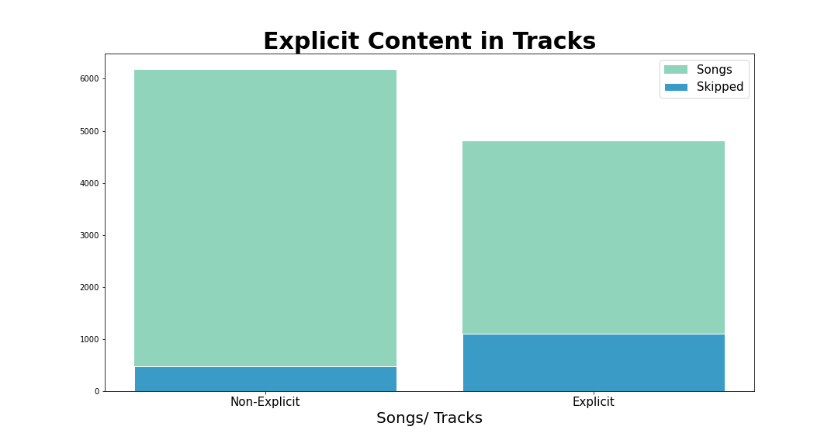
Notes:
This is the explicit tracks breakdown in my dataset. Even though there were higher counts of non-explicit content in my dataset, I skipped 1466 explicit content and only 689 non-explicit content based on my target conditions.

Slide 7

Notes:
An overview of all artists and their song breakdown.
21 Savage has 72 songs that I would skip and 28 that I would not.
Out of 100 songs, Shakira had 6 where she or a featured artist sang their name.
Surprisingly, Jason Derulo who was the main artist I could think of that I would skip songs based on this specific trait of singing their own name, only has 21 songs that I would skip and 77 that I would not.
This however makes sense, because in 2015 he said that he had outgrown singing his name, and just recently started doing it again, because ‘he missed it’.
Of course one artist that would never let me down is Rick Astley who has a total of 97 songs and none of them worth skipping.

Slide 8
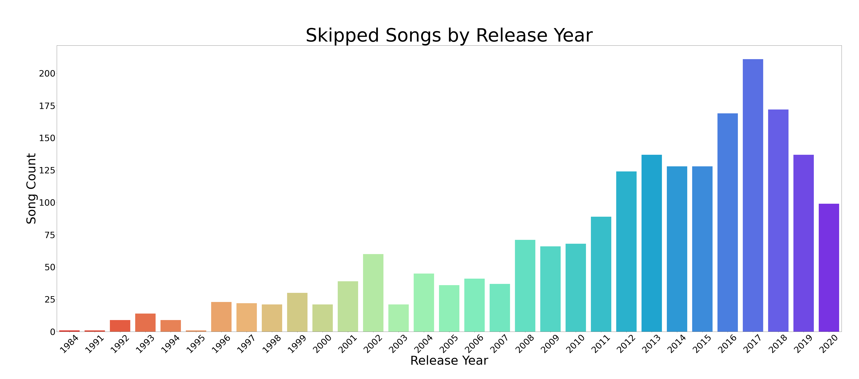
Notes:
The songs in my dataset ranged from release years 1963 to 2020. A left-skewed distribution of songs, leaning heavier, on the modern artists.
The first occurrence of an artist using their moniker within my gathered data is in 1984 by “Weird Al” Yankovic in ‘I Lost on Jeopardy’, although it was really Don Pardo who said Weird Al’s name as the announce for Jeopardy.
Following that it was 2Pac and Sublime in 1991.

Slide 9
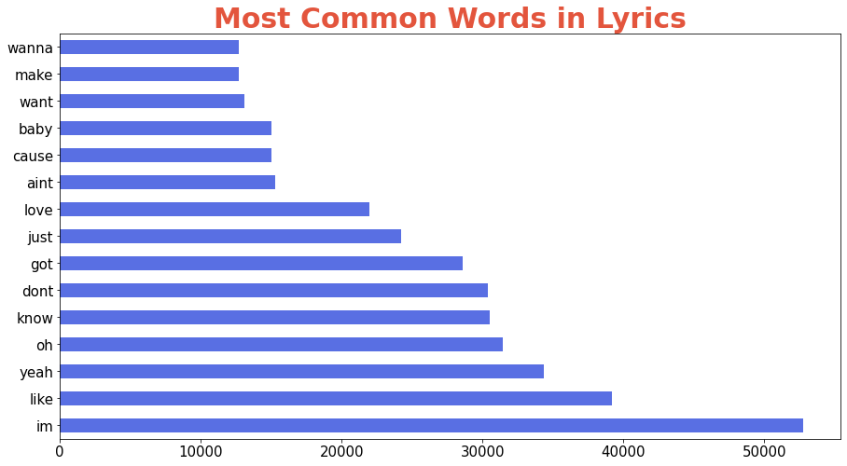
Most Common Words in Lyrics
Notes:
I used Count Vectorizer as my transformer on my lyrics column to get the most common words out of my corpus.
This helps me determine what additional words I may want to add to the stop words dictionary for Natural Language Processing.
Based on these words, I left my stop words in the Count Vectorizer to the English dictionary, however I decided to mask some words, in my pre-processing steps.

Slide 10
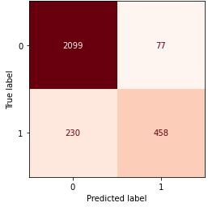
Modeling
Transformer
Count Vectorizer
TFIDF Vectorizer
Estimator
Multinomial NB
Bernoulli NB
Logistic Regression
Random Forest Classifier
AdaBoost Classifier
Notes:
Using a Pipeline function I had created for my Reddit Project.
Which takes inputs of the type of transformer, estimator, pipeline parameters and outputs a report with scores and confusion matrix.
I put all my models through the Gridsearch Pipeline with both types of transformers and each estimator.
I had a total of 10 models initially.
Count Vectorizer splits all words in a corpus and then assigns them a boolean to whether that word is in the row or not. Then counts the number of occurrences.
Whereas TFIDF finds the words that are heavier in one document over the other.
These models were chosen based on how well they do on classification problems and Natural Language Processing.
My classes were imbalanced at 76% for the not_skipped songs and 24% for the skipped songs.
Because of this I decided to use F1 score instead of accuracy. The F1 score weighs the average of precision and recall.
Decision Trees work by learning a hierarchy of if/else questions which forces it to address both classes and therefore perform well on imbalanced data.
And boosting is a sequential model that tries to build a strong, predictive model from mistakes made by the weaker base model.
My aim was to reduce false negatives. I would rather not listen to a song that should be skipped and miss a few that I should have listened to.
Of these 10 models, the best model was the AdaBoost Classifier with CountVectorizer at bigrams and DecisionTree as the base estimator.
This model correctly predicted 2099 tracks that were not skipped, 77 tracks that were skipped but should not have been, 230 tracks that were not skipped but should have been and 458 tracks that were correctly predicted as skipped.
Going back to the intent of reducing false negatives, means that as it stands, out of the 2329 tracks that were marked as not skipped tracks (true negatives and false negatives), I will encounter 230 tracks that I will end up skipping.

Slide 11
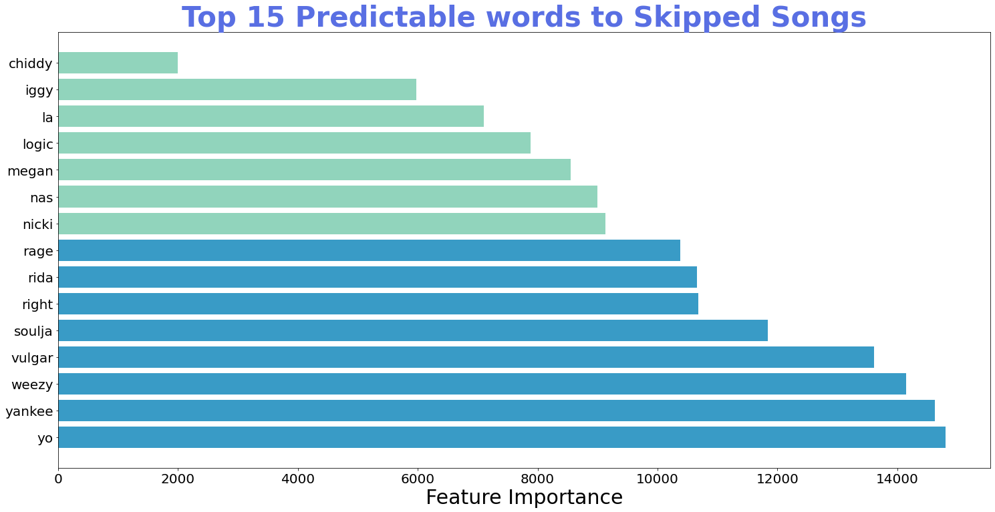
Notes:
Feature importance is a technique that assigns a score to the features based on how useful they are at predicting a target variable.
Apart from *'vulgar'* these words did not appear in the top 15 words in my EDA, it also makes a lot of sense as to why they have such heavy importance in determining which classes they belong to.
With the exception of *'right', 'yo', 'la'* all the other words are aliases or names of the artist.

Slide 12
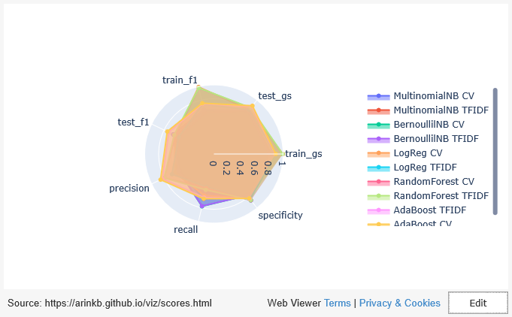
Notes:
When looking at how well my models did, What I am looking for is high but equal scoring across my train and test scores, if there is too much variation between the training set and testing set scores it is an example of overfitting.
Next I am looking at high scores for precision (which indicates how many songs were correctly classified), recall (which indicates how many skipped songs were correctly classified) and specificity (which indicates how many of the not skipped songs were correctly classified)
Looking at my best model, which was the count vectorized adaboost classifier, we can see that the training and testing scores are similar for both the accuracy score and f1 score. Scoring the highest on precision, above 65% on recall and like all other models, high on specificity.
The TFIDF version of the adaboost, scored slightly lower on precision, recall and specificity.
Now if we compare that to RandomForest (TFIDF) or Logistic Regression (CV), there is a significant difference between the training and testing f1 scores, indicating over-fitting on those models.
The Bernoulli Naïve Bayes models scored the highest on recall, and although their train and test scores were similar, the f1 scores were much lower compared to the AdaBoost Model.

Slide 13
Other Models
Modeling
Word Lemmatization
Best Model > AdaBoost with Decision Tree base and CountVectorizer bigrams
Scored slightly lower than non-lemmatized counterparts
Notes:
I attempted some additional model variations to see if I could get better scores.
Starting with Word Lemmatization which takes the words to a meaningful base form. Words like dance, danced, dancing, dances would all return to their base form of dance.
This would reduce the size of my unique words, and therefore result in less words that the model must predict to its classes.
In conclusion, all models scored slightly less than their non-lemmatized counterparts.

Slide 14
Other Models
Modeling
Word Lemmatization
Re-Sampling
Best Model > AdaBoost with Decision Tree base and CountVectorizer bigrams
Scored slightly lower than non-lemmatized counterparts
Random Over Sampling
SMOTE
Near Miss
Notes:
Next, I wanted to see what re-sampling would do to my best model.
Using the AdaBoost model as the base model, I tried 3 different resampling methods:
Random Over Sampling - which duplicates examples from the minority class in the training dataset
SMOTE - This oversampling method is different from the random over sampling method because in this method, the minority class is not duplicated but rather new samples are made based on k nearest neighbors of a randomly selected example from the minority class.
And Undersampling which removes examples from the majority class in the training dataset, Near Miss is a form of undersampling which selects examples based on the distance between the two classes. By default the technique will try to make the two classes equal in size.
Of these models the Random Over Sampler model performed the best.
Keeping it’s f1 scores in the lower 70s. This model found an additional 78 skipped songs at the cost of 155 non_skipped songs.
Although the other 2 models had an increase in true positives it was at a much higher cost of the true negatives.

Slide 15
Other Models
Modeling
Word Lemmatization
Re-Sampling
WHAT’S NEXT?
Best Model > AdaBoost with Decision Tree base and CountVectorizer bigrams
Scored slightly lower than non-lemmatized counterparts
Random Over Sampling
SMOTE
Near Miss
Neural Networks - In progress
Notes:
I wanted to try my hand at some neural networks,
Because this is a new concept to me, there is a lot more reading and research I need to do before I can get good results.
This is a work in progress that is currently yielding high true positives, minimal false negatives, however it also has higher than desirable false positives.
The words have been tokenized using the keras preprocessing library which is similar to count vectorizer and the classes re-weighted to counter the imbalance.
Next, I need to consider re-sampling methods.
Once I have a good model using neural networks, I’d like to continue my work with the Challenge’s dataset, and see how unseen data will do in my model.

Slide 16
Thank You!
Questions?
Arink Bertrand
LinkedIn: arink-bertrand
Github: ArinkB
Notes:
Thank You everyone.
I am open to any questions you may have.
Term Frequency-Inverse Document Frequency Vectorizer
KNN - similar things are near to each other.
SMOTE - synthetic minority over sampling technique
Overfitting happens when a model learns the detail and noise in the training data that it negatively impacts the performance of the model on new data. How well the model does on new information
Precision the number of true positives divided by all positive predictions. Precision is also called Positive Predictive Value. It is a measure of a classifier’s exactness. Low precision indicates a high number of false positives.
Recall - the number of true positives divided by the number of positive values in the test data. Recall is also called Sensitivity or the True Positive Rate. It is a measure of a classifier’s completeness. Low recall indicates a high number of false negatives.
accuracy will always predict on the heavier class when imbalanced
Sequential Learners, where different models are generated sequentially, and the mistakes of previous models are learned by their successors. This aims at exploiting the dependency between models by giving the mislabeled examples higher weights (e.g. AdaBoost).
Feature importance – weighted average over each tree in the decision tree of the adaboost model
NearMiss-1: Majority class examples with minimum average distance to three closest minority class examples.
NearMiss-2: Majority class examples with minimum average distance to three furthest minority class examples.
NearMiss-3: Majority class examples with minimum distance to each minority class example.
Boosting in Ensemble Methods
Just as humans learn from their mistakes and try not to repeat them further in life, the Boosting algorithm tries to build a strong learner (predictive model) from the mistakes of several weaker models. You start by creating a model from the training data. Then, you create a second model from the previous one by trying to reduce the errors from the previous model. Models are added sequentially, each correcting its predecessor, until the training data is predicted perfectly or the maximum number of models have been added.
Boosting basically tries to reduce the bias error which arises when models are not able to identify relevant trends in the data. This happens by evaluating the difference between the predicted value and the actual value.

Slide 17
Crowd AI Skip Challenge
SNL – Rap Song Skit
57 Minutes of Jason Derulo
Best Song in Dataset
Sources

